Slide 1
The Fishbowl- a metaphor
This Photo by Unknown Author is licensed under CC BY
Guidelines for Socratic Dialogue (Loosely based on the Padeia Seminar)
Mrs. Shriver

Slide 2
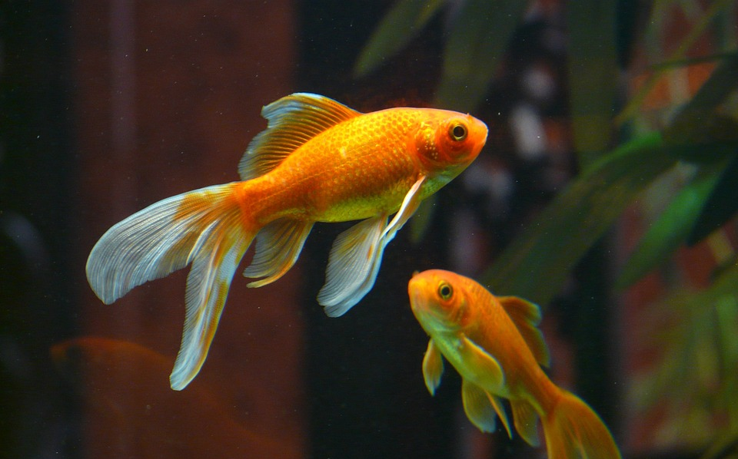
Why call it a ”fishbowl”?
Because when we share ideas, we feel exposed (everyone’s watching me!)
What fishbowls teach us is that our ideas are GREAT!!! Others will LOVE our ideas.
Fishbowls give us confidence!
We are all “gold” fish!!!!

Slide 3
Socrates
“the highest form of Human Excellence is to question oneself and others.”

Slide 4
What is a Socratic Dialogue?
A Socratic Dialogue is based on the questioning techniques of Socrates, a classical Greek philosopher who was convinced that the surest way to attain reliable knowledge was through the practice of disciplined conversation.

Slide 5
What is the thinking behind it?
Participants will seek deeper understanding of complex ideas in the text through thoughtful dialogue.
Many people have pieces of answers, so cooperation can lead to a greater understanding.
The assumption is NO ONE has the right answer. We arrive at a better understanding TOGETHER.

Slide 6
It’s a competition or a debate. It’s collaboration.
Fishbowls enable us to work collaboratively to understand, make meaning and find common ground.
First, everyone examines a common piece of text.
Next, each person creates THEIR OWN questions based on what they thought about as they read,
Each participant will come bringing four types of questions: open-ended, world connection, connection to other pieces of writing, and rhetorical analysis questions.
This Photo by Unknown Author is licensed under CC BY-NC-ND

Slide 7
How is the fishbowl conducted?
Everyone prepares four questions.
Students are divided into two groups: the outer circle and the inner circle.
Each group has 20 minutes to discuss the work.
The group leader must ensure they everyone speaks at least ONCE.
Without any teacher intervention, the goal is to discuss fully the piece of writing.
After 20 minutes, the groups switch places.

Slide 8
Outer Circle Options
Option 1- Computer out. They type at least one question or comment they in response to what they heard going on in the inner circle. They will not comment to the group at large, but will post in an online discussion.
Option 2- Paper Out. Students write a response to a comment or question based on an idea provoked by the inner circle comments.
Option 3- Active Listening. Students practice simply listening. No phone out. No computers out. Nothing but attention.
Option 4- Active Listening but will follow up questions.

Slide 9
Outer Circle Follow-up Questions
What was the most interesting question posed (asked) by an outer circle participant?
What was the most profound (intelligent) statement made by an inner circle participant?
What new enlightenment (understanding) did you gain about the book as a result of today’s discussion?
What statement(s) would you have added to the discussion if you had been part of the inner circle?

Slide 10
Inner Circle
Asks the prepared questions.
Makes relevant comments during the seminar which show response to questions. Helps to enlarge understanding of the text and ideas generated by the seminar.
Uses the text itself to flesh out ideas presented.
Shows attentiveness through body language (i.e. sitting up straight, looking at the speaker)
Realizes this is not a debate
Supports others’comments and thinking even if challenging a specific line of reasoning.
Does not belittle or criticize, disparage or claim to assume another person’s motives.

Slide 11
Social contract style Listening and Speaking phrases for a fishbowl
Suggested stems for discussions:
1. I agree with _______ because, but I want to add another reason why I think____________________________________.
2. I disagree with _______________ because __________________________.
3. I’m not sure why _____________ said___________________________. Could you reword your comments to help me understand?
4. I understand your point, _______________________, but I want to add/disagree/give another example _____________________________.
5. This is what I think you are saying, ____________________________ and I would like to add/or disagree by saying _____________________________.

Slide 12
Prep for a Fishbowl
Participant Preparations & Question-Writing

Slide 13
What do we all do before the fishbowl?
Read the text thoroughly, marking passages as you read.
Become familiar with unique vocabulary.
Brainstorm main claims and line of reasoning
Identify the rhetorical situation (context)
Become aware of specific uses of language, such as simile and metaphor.
Identify specific rhetorical choices that stand out.
Create questions – one (1) of each type listed below.

Slide 14
OPEN-ENDED QUESTIONS
deal directly with the text and requires proof, insights, and group discussion to discover or explore the answer to the question.
Example:
What does the term “equivocate” mean in the context of this essay?
Why do you think she was asked to give this speech as opposed to anyone else? Is there something she says in the speech that gives us a clue to this?

Slide 15
WORLD CONNECTION QUESTIONS
make a correlation between the text and the real world.
Example:
“Is there anything today that carries the same kind of social stigma that AIDS did in 1992?
“To what degree has public perception towards AIDS changed since 1992?

Slide 16
UNIVERSAL THEME QUESTIONS
deal with a theme of the text and encourage discussion about the universality of the text.
Example:
She identifies shame as a huge problem in solving social issues, to what degree does shame affect how many of us live our lives and keep secrets today?

Slide 17
LITERARY/RHETORICAL ANALYSIS QUESTIONS
are about the author’s writing style and may focus on how the author manipulates point of view, creates characters, or uses language to create a specific effect.
Connections can also be made with other pieces of writing that use different arguments to concur or challenge the viewpoint.
Example:
“What does Mary Fisher invoker her children so often during her 1992 speech at the Republican convention? – rhetorical choices
”How does Sotomoyor’s use of personal stories or even the Spanish language enhance her or central argument?”

Slide 18
Rubric
You must READ and ANNOTATE the passage. This can be brought to class physically unless otherwise noted by Mrs. Shriver. 20 points
You must have all four questions either handwritten on the piece or written on a separate sheet of paper. 20 points
You must speak at least ONCE during the seminar. 10 points
You must have at least ONE comment in the online discussion made during real time. 10 points
***GROUP LEADER MUST MAKE SURE EVERYONE ASKS A QUESTION OR MAKES A COMMENT DURING THE FISHBOWL.

