Slide 1
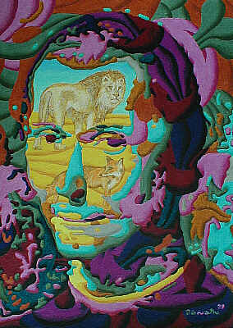
Machiavelli’s The Prince
“The most famous book on politics ever written.”-
The father of modern political science.

Slide 2
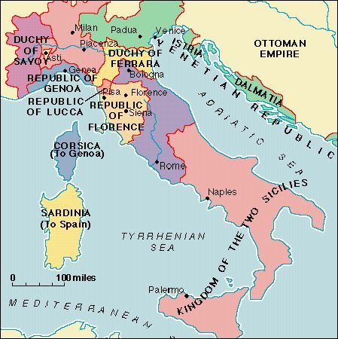
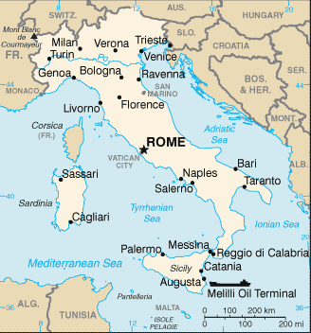
The World of Machiavelli
Old Italy
Modern Italy

Slide 3
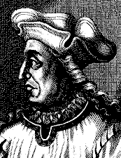
Who was Macchiavelli?
Born in Florence on May 3, 1469.
He worked his way through the political
circles in Florence. He became a
secretary to the Council of Ten,
the governing body in charge of diplomacy and military organization for the Florentine republican government.
He carried out several diplomatic missions in this role meeting king, popes and other power brokers.

Slide 4
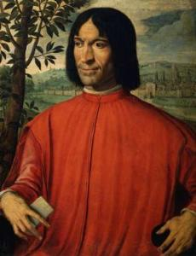
The Medici Family
The Medicis are very closely associated with the high
point of the Renaissance including Leonardo de Vinci and Michelangelo.
They ruled Florence for almost 3 centuries (1200s- 1500s). Florence was one of the most important city states.
The Medici family regained power in Florence in 1512, thus putting an end to the republic.
As a result, Machiavelli lost his job,
was temporarily imprisoned and tortured.
He dedicated The Prince to Lorenzo
de Medici in an attempt to gain favor
with the ruling family.

Slide 5
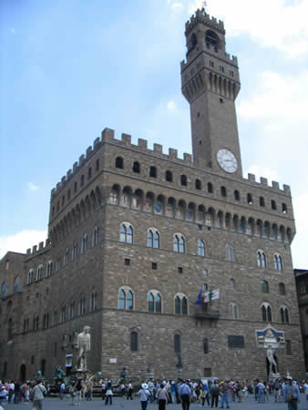
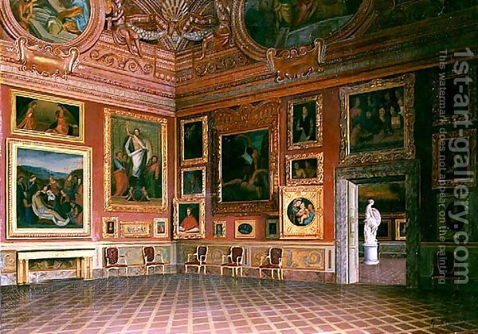
Medici Palace in Florence Italy

Slide 6
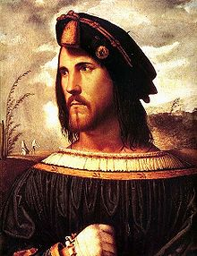
Cesare Borgia
He is often referred to in The Prince as the model for an ideal ruler. He is one of the political rulers of the day powerful Borgia family.
Interesting facts about Cesare- son of Pope Alexander VI (Rodrigo Borgia). Pope Alexander
Is known as the most worldly and
selfish pope of all time- yikes!
Cesare is one of the “hero”s of the
book. He conquered
most of northern Italy.

Slide 7
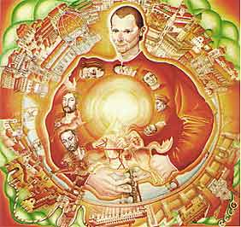
The end of Machiavelli
Machiavelli was never reappointed to his old position because he was associated with a plot to get rid of the Medicis (likely not even true).
Machiavelli died without ever
getting back into politics or
publishing The Prince.
The Prince was published in
1532- five years after his death.

Slide 8
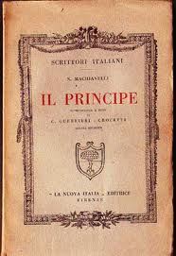
Style and Structure
Most of this book is written in the
first person.
Dedicatory letter- openly
addresses Lorenzo Medici
Often uses second person
Written in Italian
Meant to be logical: it starts with general types of political situations and examines them each for a few chapters before going on to a few specific issues.

Slide 9
Themes- Politics
The book is written as a handbook. It offers practical advice to a new prince or leader in how to gain, consolidate, and keep political power.
Prior to Machiavelli, political theorists judged a prince’s reign on how “moral” the prince was: did he go to church? Did he sin? Was he a good man? Yet Machiavelli contends that it always being “good” doesn’t make you a good leader because the world isn’t good.
He is very interested in how a prince is PERCEIVED by his subjects. He must APPEAR to be good- and that sometimes means something very differently.
.

Slide 10
Machiavelli’s view of the world
Nation- states are a temporary thing- they are aggressive in nature and dynamic
It is all about power and force
A prince must always preserve his “state”: his state as a leader but also preserve the state of his kingdom.
The prince with great strength or “virtue” canthen be in a position to provide peace and prosperity to his people.
Because in order to preserve his state, he will be put in morally compromising positions, a prince is not held to the ethical standards of common man- preservation of one’s state is the first and most important law of nature. Everything is ethical for self-preservation.
This is the beginning of moral relativism

Slide 11
Does Machiavelli believe in tyranny or a republic?
Modern democratic government was founded upon the principle of limited government- Machiavelli would find this naïve.
We are familiar with the term “unalienable rights”- Machiavelli would say there is no such thing in reality.
According to Machiavelli, a good prince must always be aware that competing elite forces from within and without seek to oppress common people. It is his job to bring glory to his state.
Many before him believed in the goodness of man and that good men would elect and choose to do what is best for everyone. Machiavelli says that’s what people SAY but not what they do.
Machiavelli sees man, in some ways, more beastly. He believes it takes strong leaders to create a peaceful state (the purpose of the Prince), but Machiavelli wrote a second book The Discourses of Levy which defends the concept of the republic.

Slide 12
It’s controversial nature
As soon as it was published it was denounced as a heretical work. It was referred to as an “imp”, “hell-bourne”, a “damnable fiend” of the underworld, the “gret monster-master of hell”.
It was placed on the Papal Index of Prohibited books in 1559.
By the 19th century, his ideas of moral relativism were no longer shocking.
By the 20th century it was common reading. However, the world “Machiavellian” is still used as an insult implying dishonesty or greed.

Slide 13
Fate, Chance and Virtue
Fortune (fortuna) for Machiavelli represents events that are beyond human control.
Virtue (virtu) means the things people can do to control fate- our personal strength of character.

Slide 14
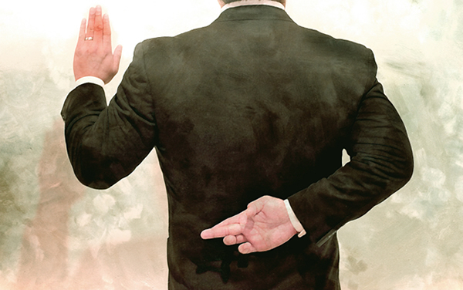
Deception
Political leaders
should be allowed
to deceive their
subjects. The test
of a politician is not
how well he keeps
his word, but whether he is PERCEIVED to be honest.
It is NOT Machiavelli’s goal to uphold morality, but to advise political leaders on the best way to strengthen their state. For him, often to remain in power means you must tell people what they want to hear- whether it is true or not. This is very controversial, but Machiavelli argues, it’s what everyone is doing already.

Slide 15
Keeping Faith
Machiavelli says it is actually harmful for a prince to tell the truth all the time. He says a “prudent” ruler” “cannot observe faith, nor should he, when such observance turns against him, and the causes that make him promise have been eliminated.”
“Observing faith” like “keeping faith” means to remain true and honest. Macchiavelli believes that a prince should break his promises when circumstances change and then lie when he breaks his promises.
Moral relativism- changing one’s ethical code for one situation to the next- is essential.

Slide 16
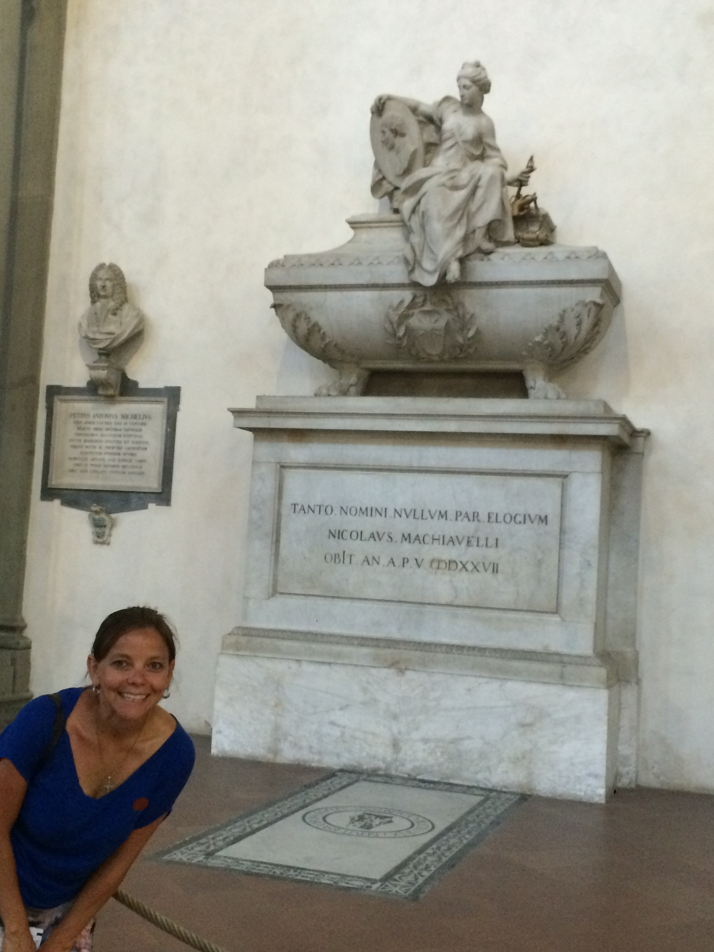
Why read The Prince?- Pick all that apply
It was written to someone who would be a prince- a role none of use will ever play.
A) It’s valuable because it’s old. It’s 100 years older than Shakespeare.
B) Modern society loves the “anti-hero”-the guy who engages in immoral
behavior in order to preserve morality (yes, it’s a paradox)
C) A teacher told me to
D) The principles can be applied
Today and I can use them as a leader.
E) Leaders are using these principles and I
Should be aware of them.
F) I am an immoral person and am looking
for treacherous ideas.
G) ________________________________.

Slide 17
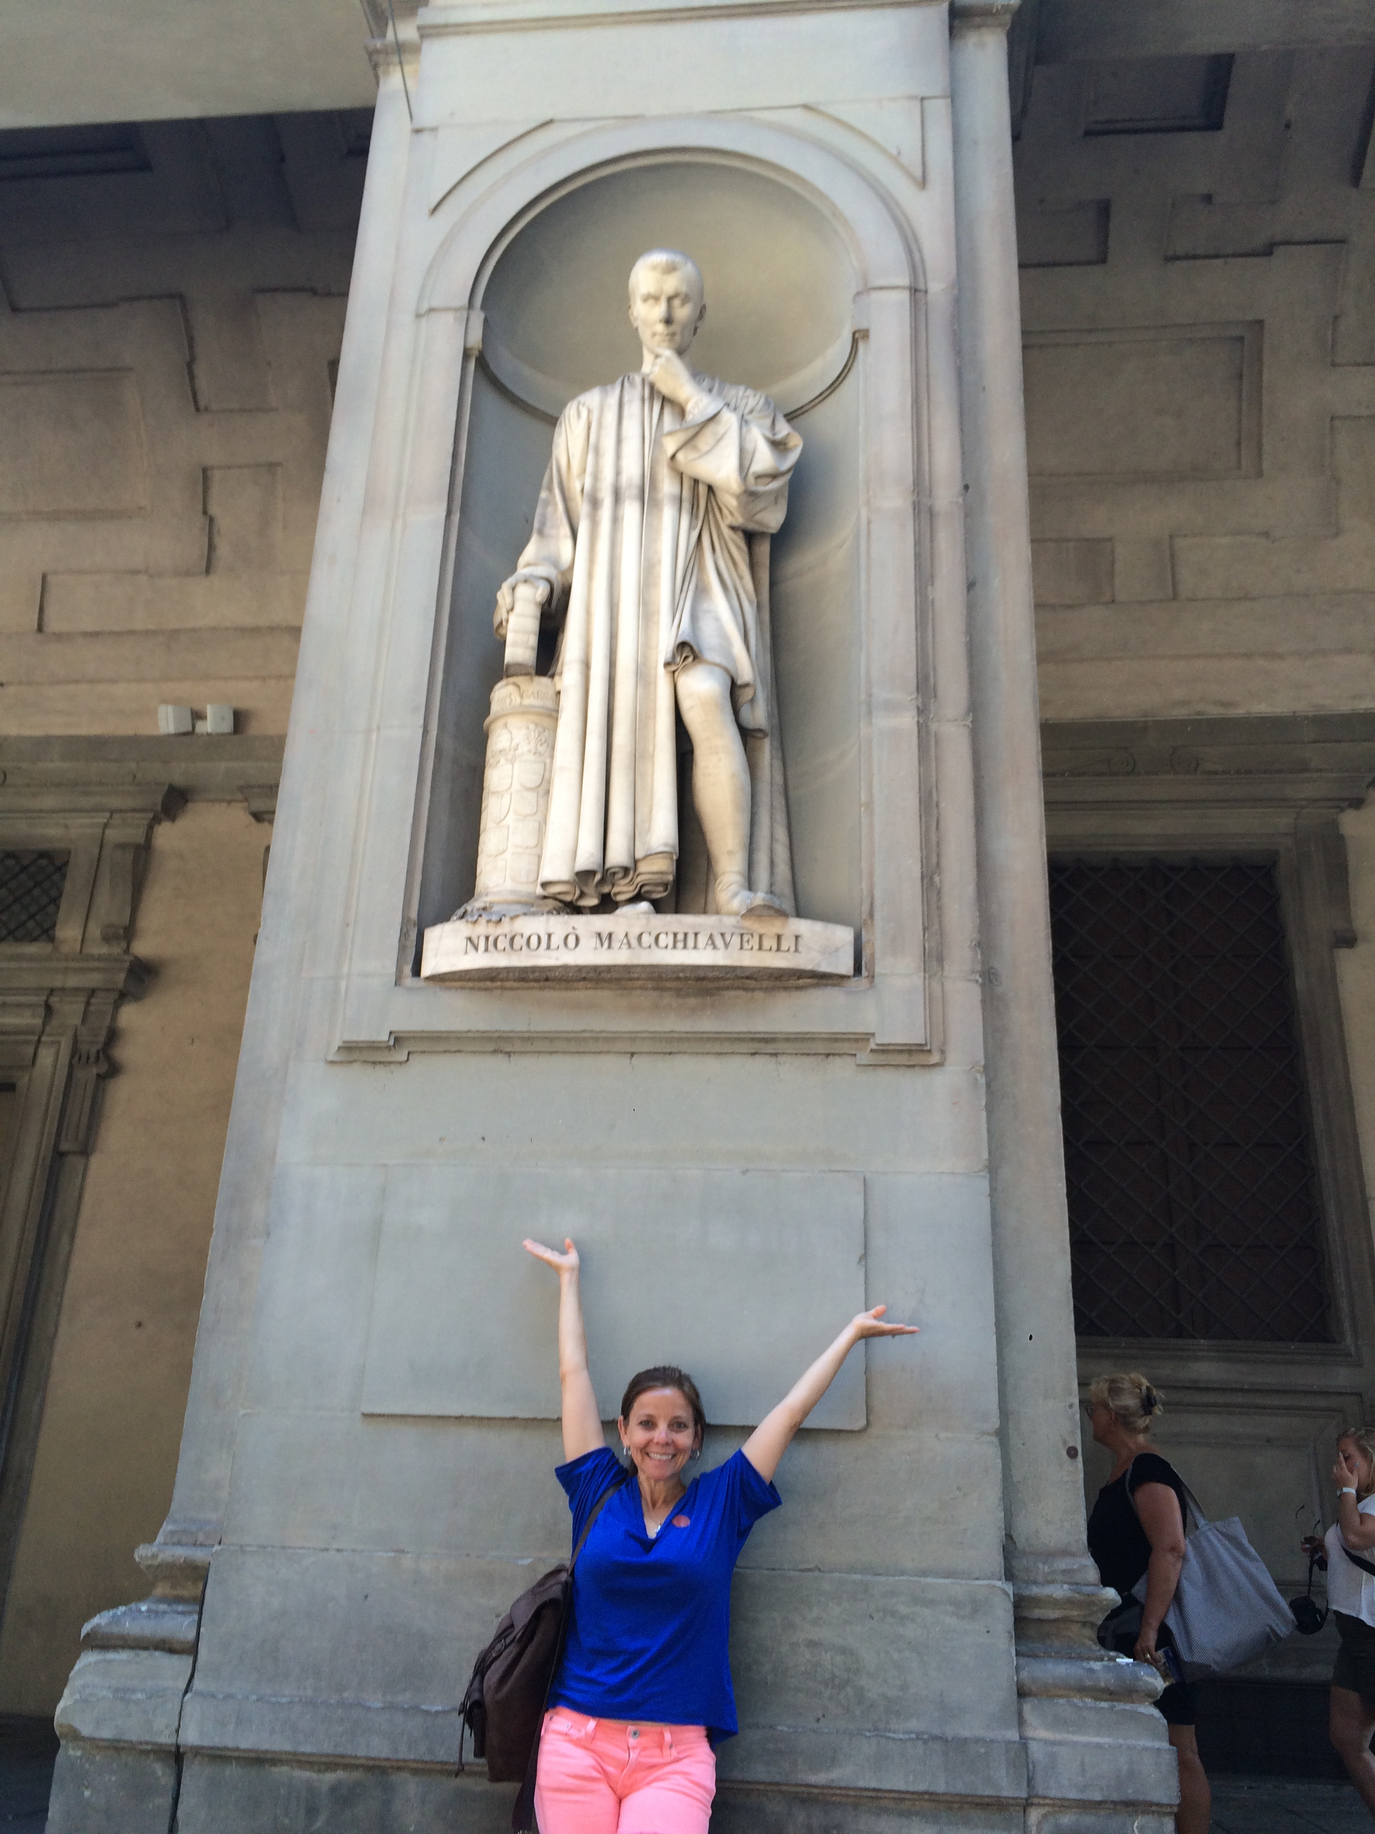
What’s his craziest piece of advice?
Lie to one’s subjects, then lie about why you lied when caught
Lure others into positions of
trust, then kill them
Hide behind others when one’s
crimes are caught
Start wars for no reason
just to keep the troops sharp

Slide 18
Does his advice make sense? If applied, would it be effective and build a peaceful society?
Does society work when rulers rule in this way?
If everyone gets off the road and drives on the shoulder- would that function in a traffic jam?
Why do people praise Machiavelli?
Are honest people just dreamers and corrupt people just realists?
These
are questions to
Consider as you
Read!!!!!!!

